Slide 1



A
Presentation
on
“Rent Ride”
Prepared By:
Alpesh M. Chauhan (8022055191)
Dhruv R. Rathva(8022055065)
Mitali J. Vasava (8022056127)
Guided by:
SHIVANGI SAMAJPATI

Slide 2


A journey plan without a car is a waste
Have no car ? Don’t worry! Rent Ride a Car rental system can solve your problem.

Slide 3

Topic Outlines
1
Definition
6
Diagram
4
System Requirement
5
Modules
3
Scope and Objectives
2
Abstract

Slide 4
Topic Outlines
1
Definition
2
Abstract
3
Scope and Objectives
4
System Requirement
5
Modules
6
Diagram

Slide 5
1. Definition
The "Car Rental System (Rent Ride)" is a web-based application designed to facilitate car rental services. The platform allows users to browse, book, and manage car rentals while enabling administrators to manage car listings, bookings, and user information. The project aims to simplify the car rental process by providing a user-friendly interface and efficient management tools.

Slide 6
2.Abstract
"Rent Ride" is a dynamic and interactive car rental web application designed to cater to the needs of both customers and administrators. The system offers features like car browsing, online booking, booking cancellation and invoice printing for users. Admins can manage car inventories, update prices, and monitor booking data. The system ensures scalability, security, and ease of use. The application enhances efficiency, minimizes errors, and ensures a seamless experience for both users and administrators.

Slide 7
3.Scope and Objectives
Scope
Using the system we can serve individual customers and can be used small to medium car rental businesses.
Using the system we can supports online booking, multiple car categories, fuel type, and price updates.

Slide 8
3.Scope and Objectives
Objectives
To provide a hassle-free car rental service for users.
To automate car inventory and booking management for administrators.
To create a reliable and efficient platform that enhances customer satisfaction and operational efficiency.

Slide 9
4.System Requirements
Processor:- Intel i3 or above.
RAM:- 4GB Minimum or 8 GB
Storage:- 20 GB minimum or 256 GB
Operating System:- Windows 10 or above/Linux/Mac OS
Development Tools:- Visual Studio Code
Server:- XAMPP Server
Browser:- Chrome, Firefox, or any modern browser.
UI Design:- HTML, CSS, Jscript
Backend:-PHP
Database:- MySQL
Software Requirements
Software Requirements

Slide 10
5.Modules
3
Scope and Objectives
2
Abstract
User
Module

Slide 11
User Modules
1
User Registration and Login
2
User Authentication
3
Browes available cars (e.g., fuel type, seating capacity)
4
View car details (e.g., model, price per day)
5
Book a car and
Print invoice
6
View booking history and cancel reservation

Slide 12
5.Modules
3
Scope and Objectives
2
Abstract
Admin
Module

Slide 13
Topic Outlines
1
Admin Login
And Dashboard
2
Admin can create and manage car brand
3
Admin can post vehicle and also manage vehicle
4
Admin can view user bookings and can also manage bookings
5
Admin can see the details of registered user
6
Admin can update contact info. and manage contact us queries

Slide 14
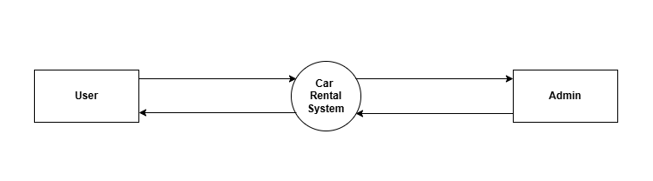
6.Diagram
DFD
Level 0

Slide 15
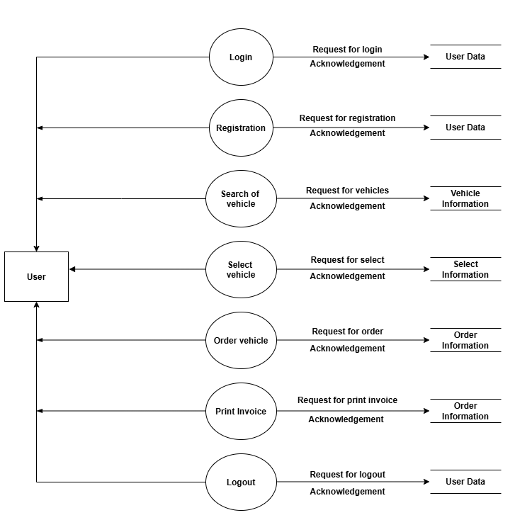
6.Diagram
DFD
Level 1

Slide 16
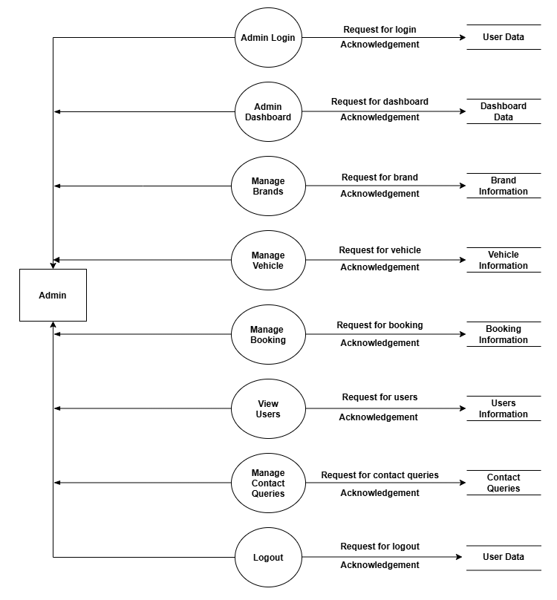
6.Diagram
DFD
Level 2

Slide 17
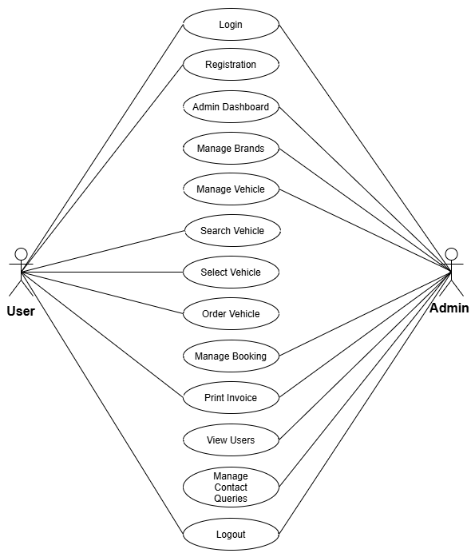
6.Diagram
Use case

Slide 18
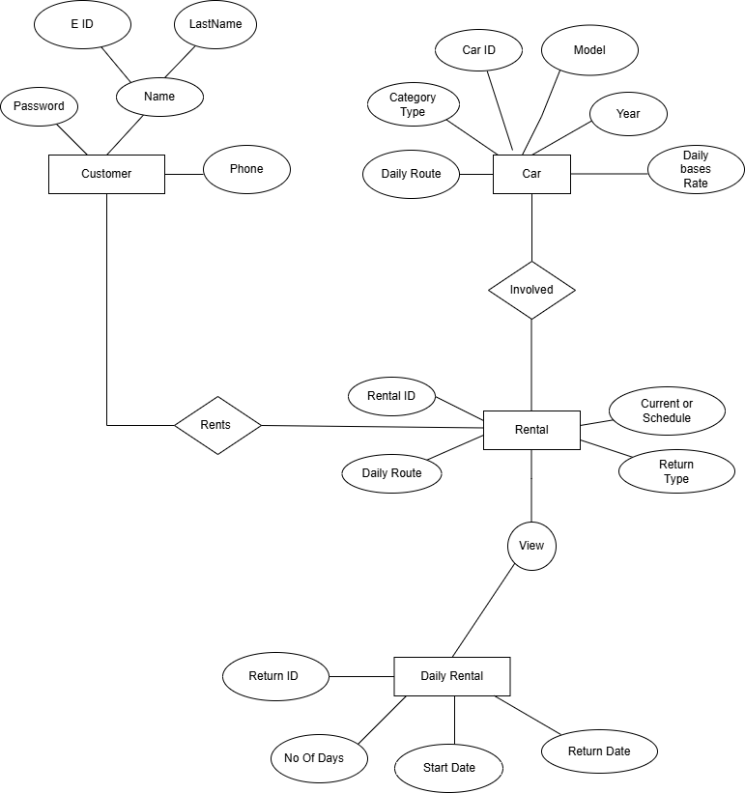
6.Diagram
ER

Slide 19
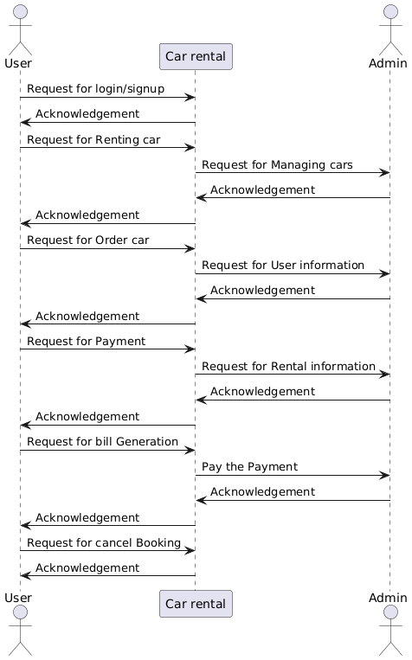
6.Diagram
Sequence Diagram

Slide 20
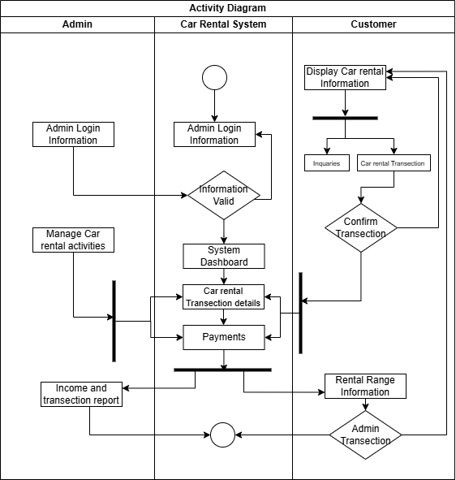
6.Diagram
Activity
Diagram

Slide 21
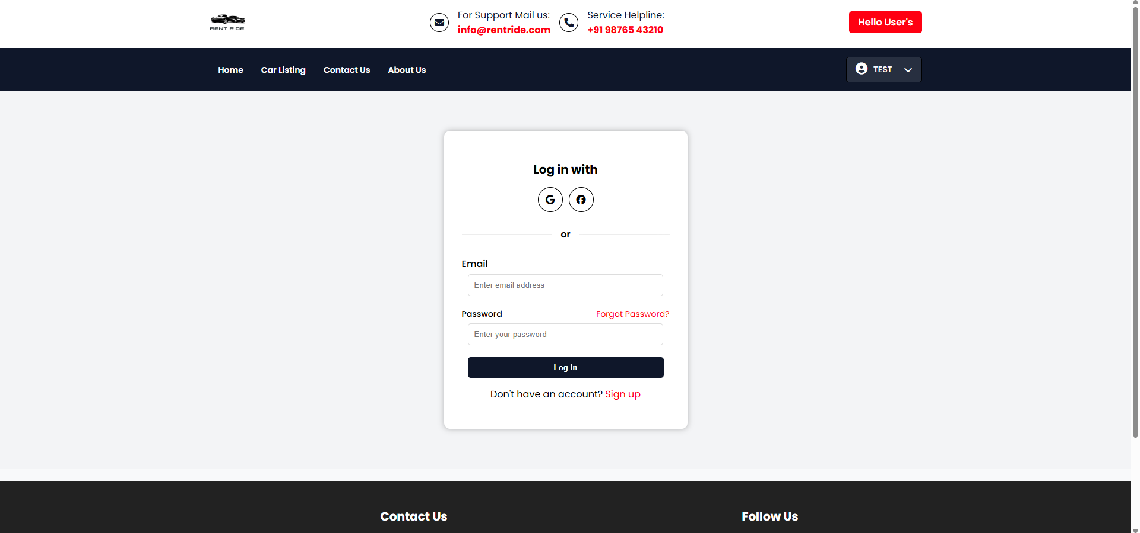
Layout for User Side:
Login Page:

Slide 22
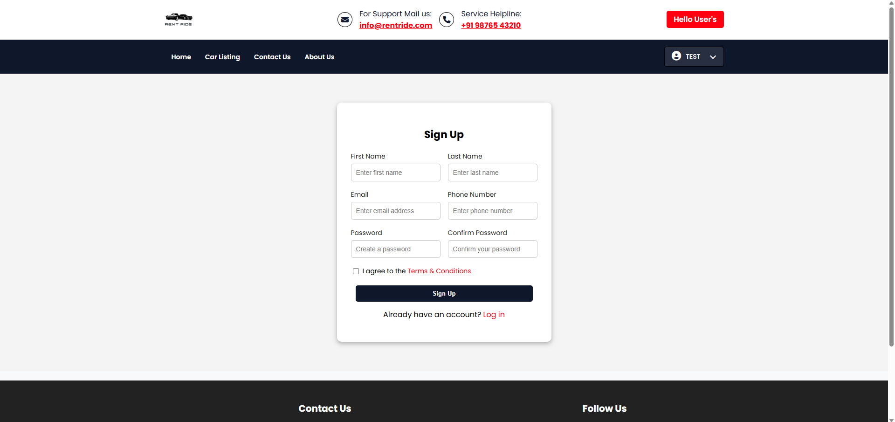
Layout
2) Registration
Page:

Slide 23
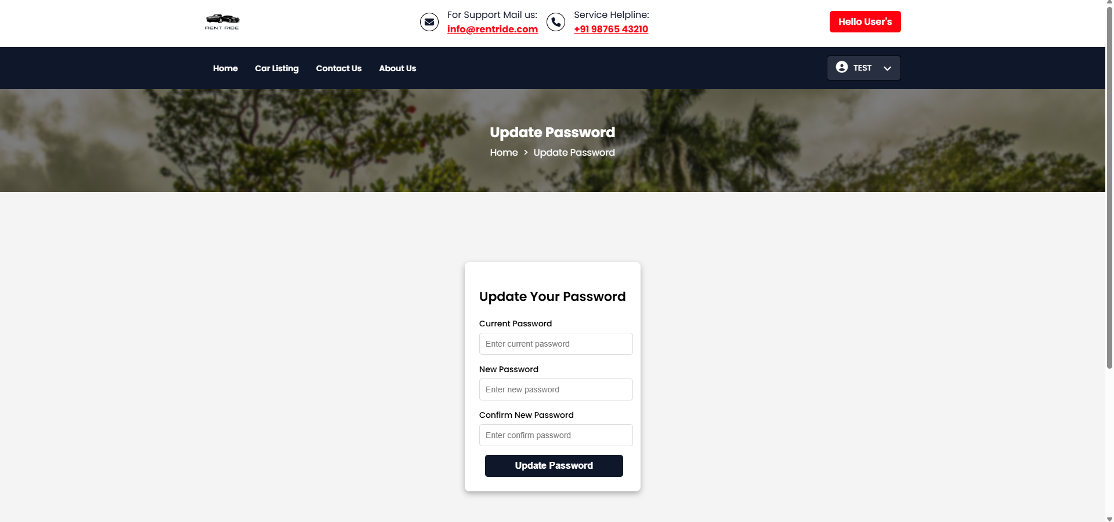
Layout
3) Update
Password:

Slide 24
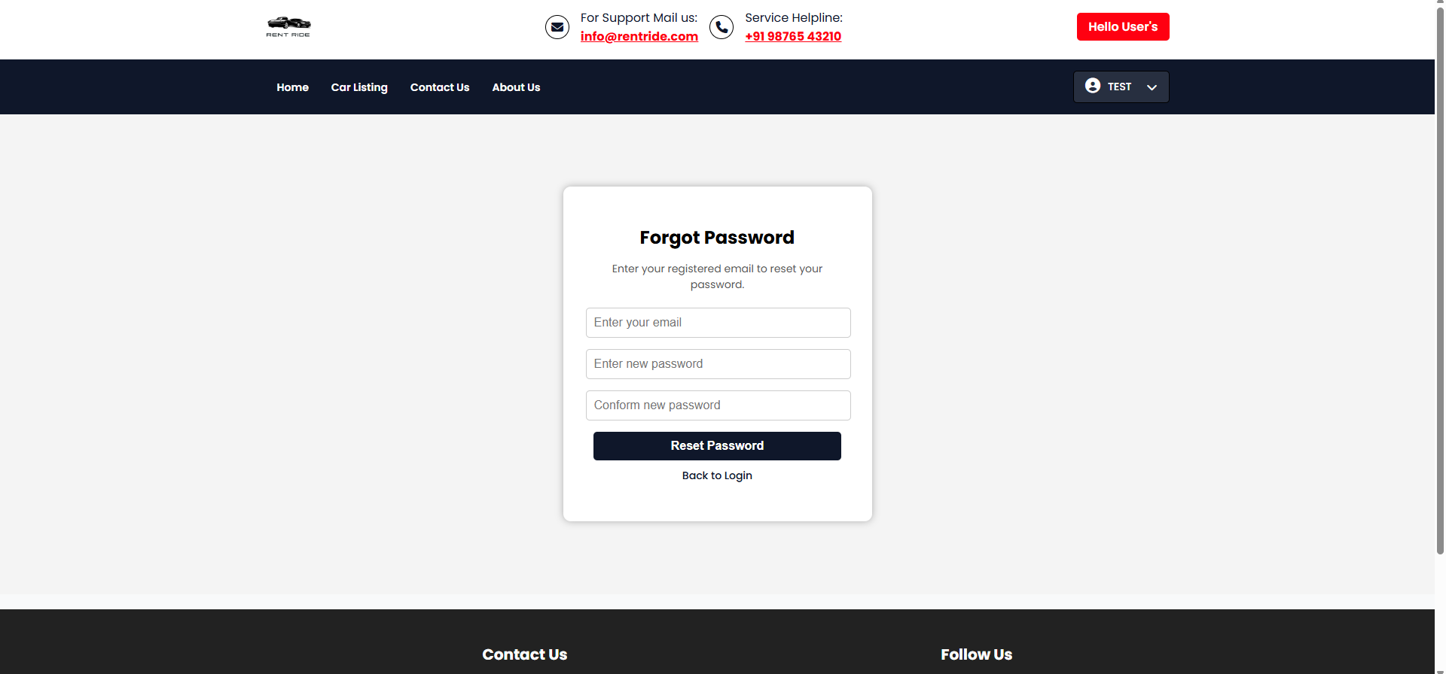
Layout
4) Forgot
Password:

Slide 25
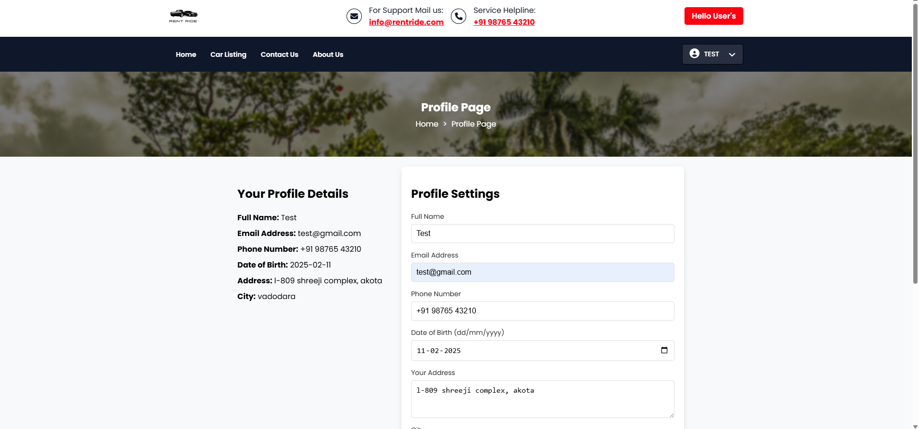
Layout
5) Profile Page:

Slide 26
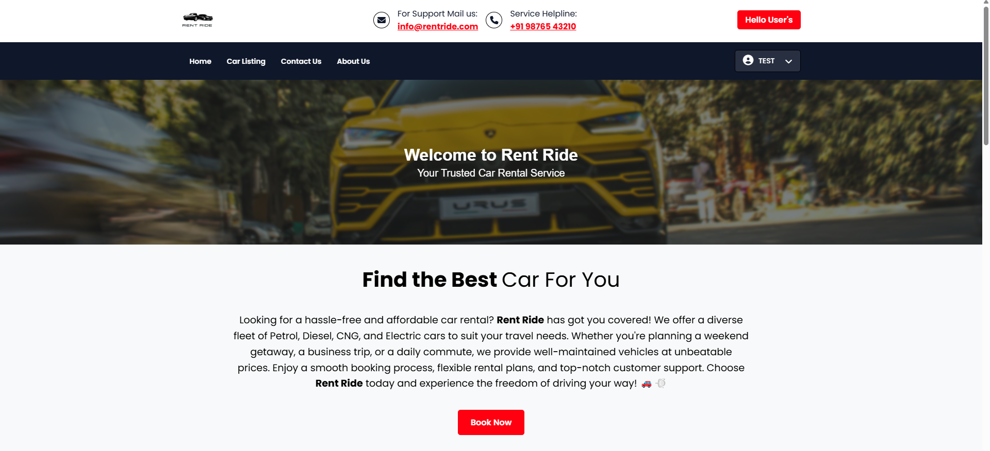
Layout
6) Home Page:

Slide 27
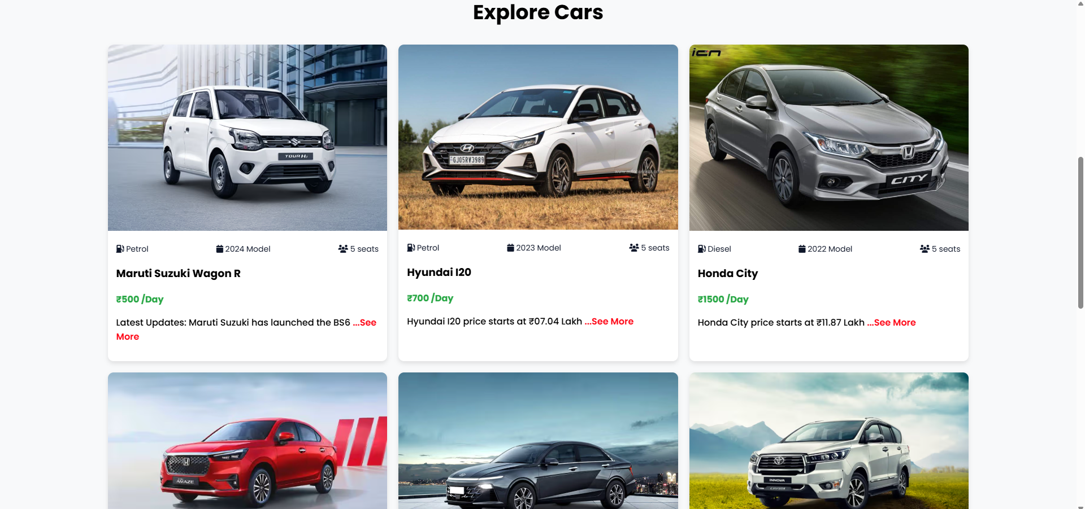
Layout
6.1) Home page :

Slide 28
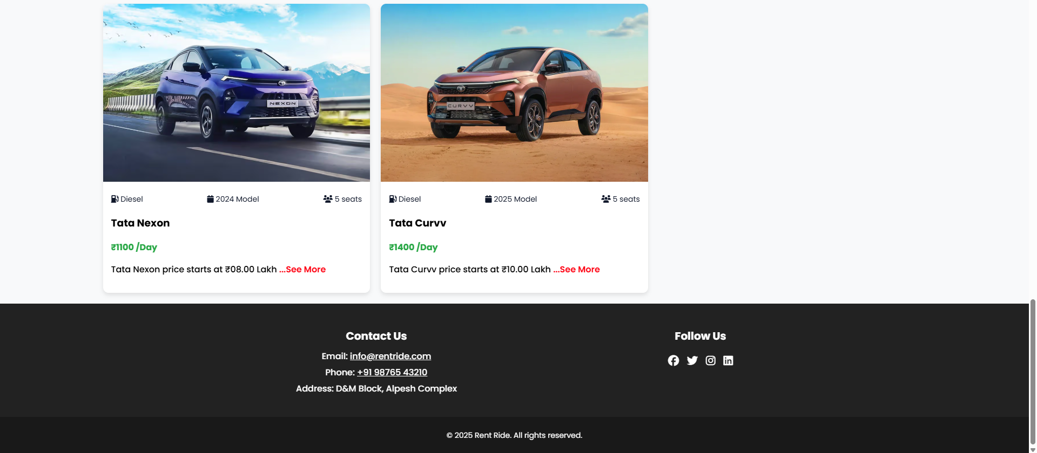
Layout
6.2) Home Page:

Slide 29
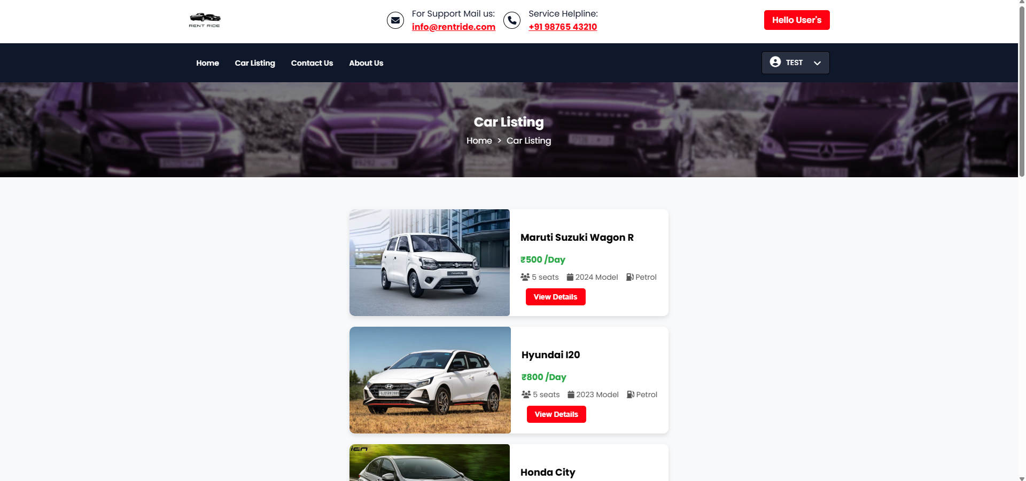
Layout
7) Car Listing:

Slide 30
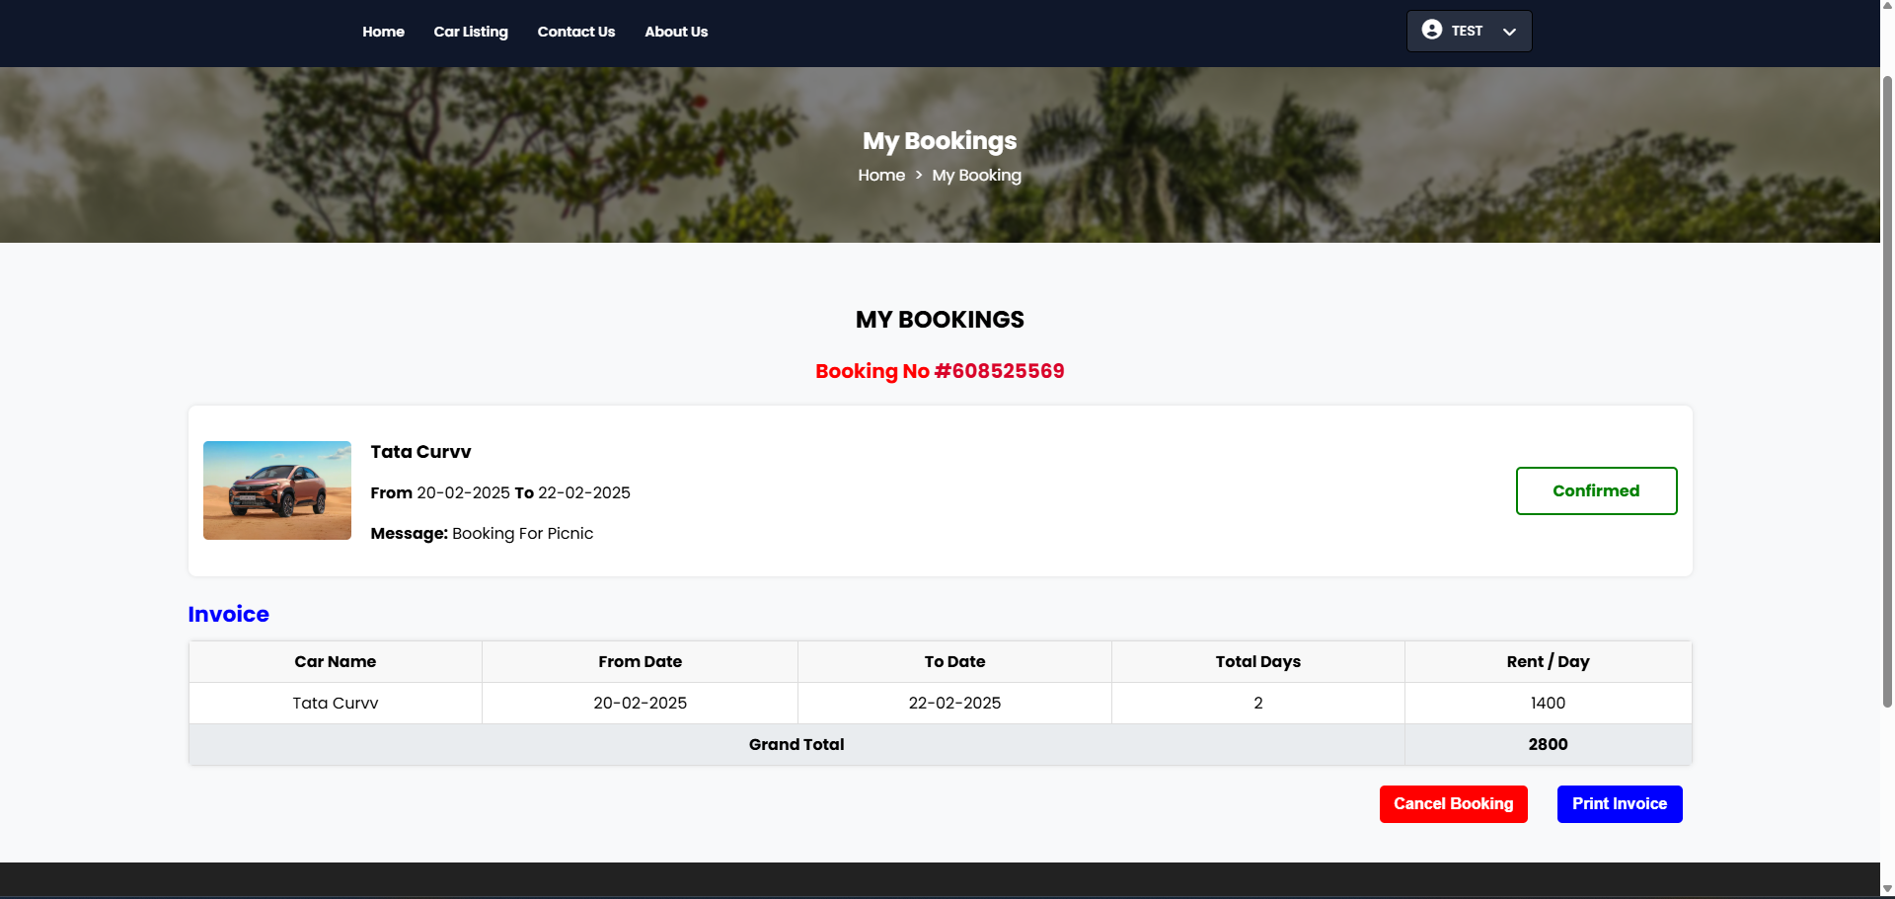
Layout
8) Booking Car:

Slide 31
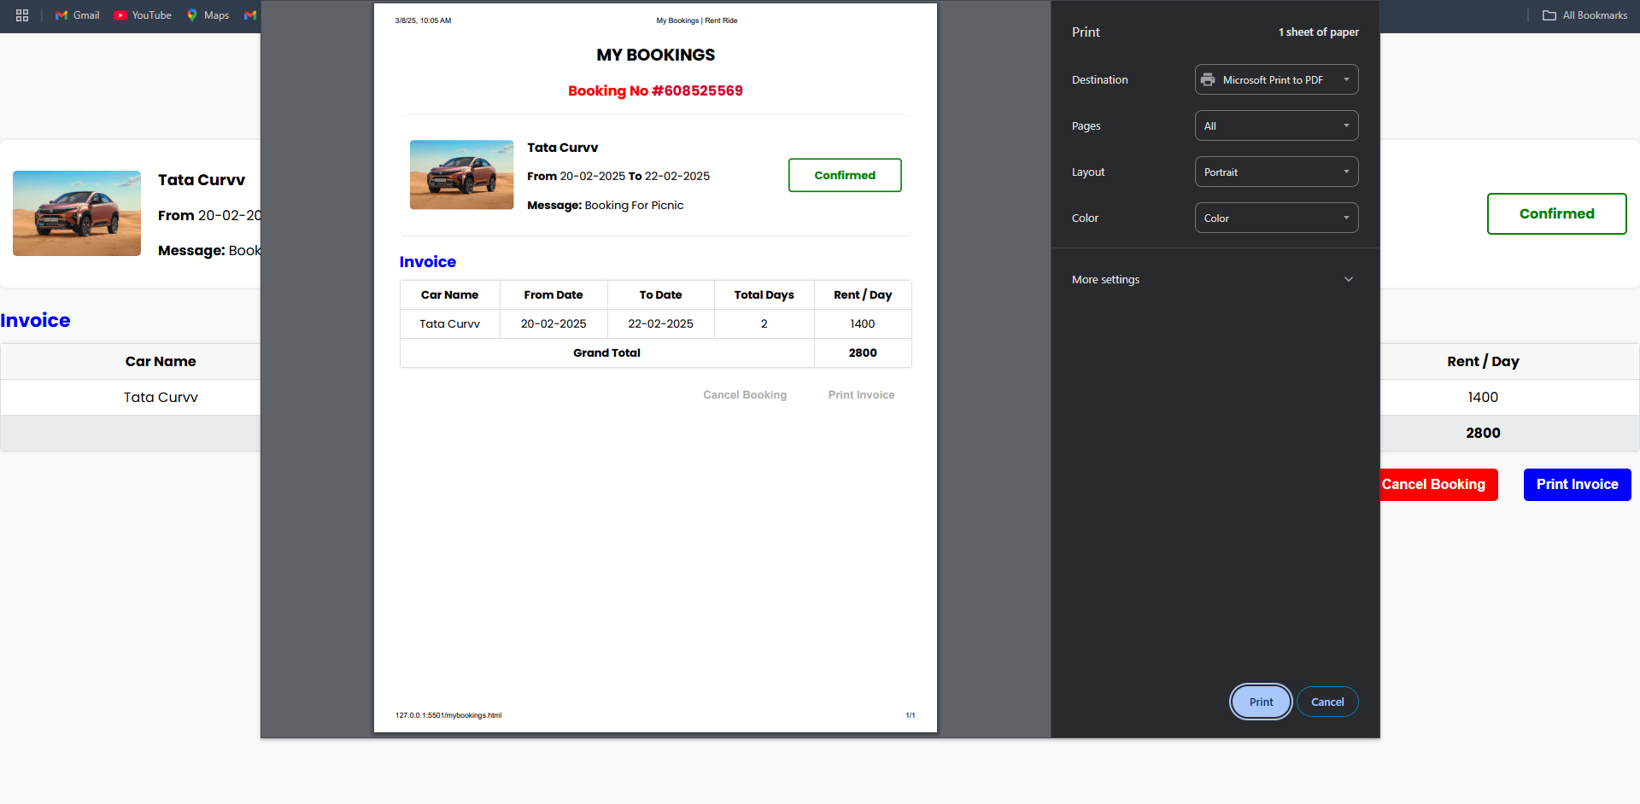
Layout
9) Print Invoice:

Slide 32
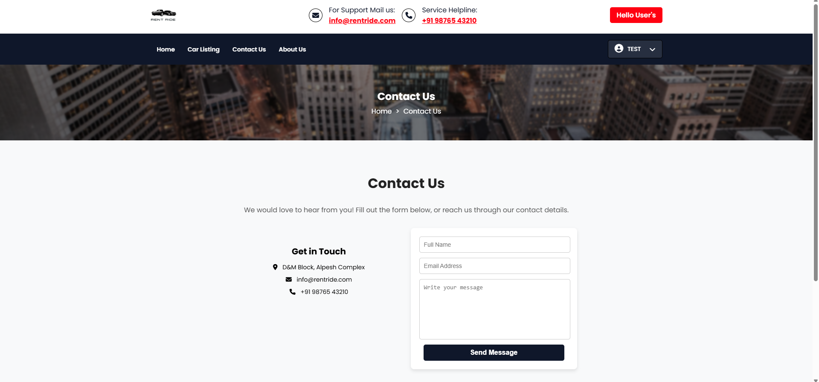
Layout
10) Contact Us Page:

Slide 33
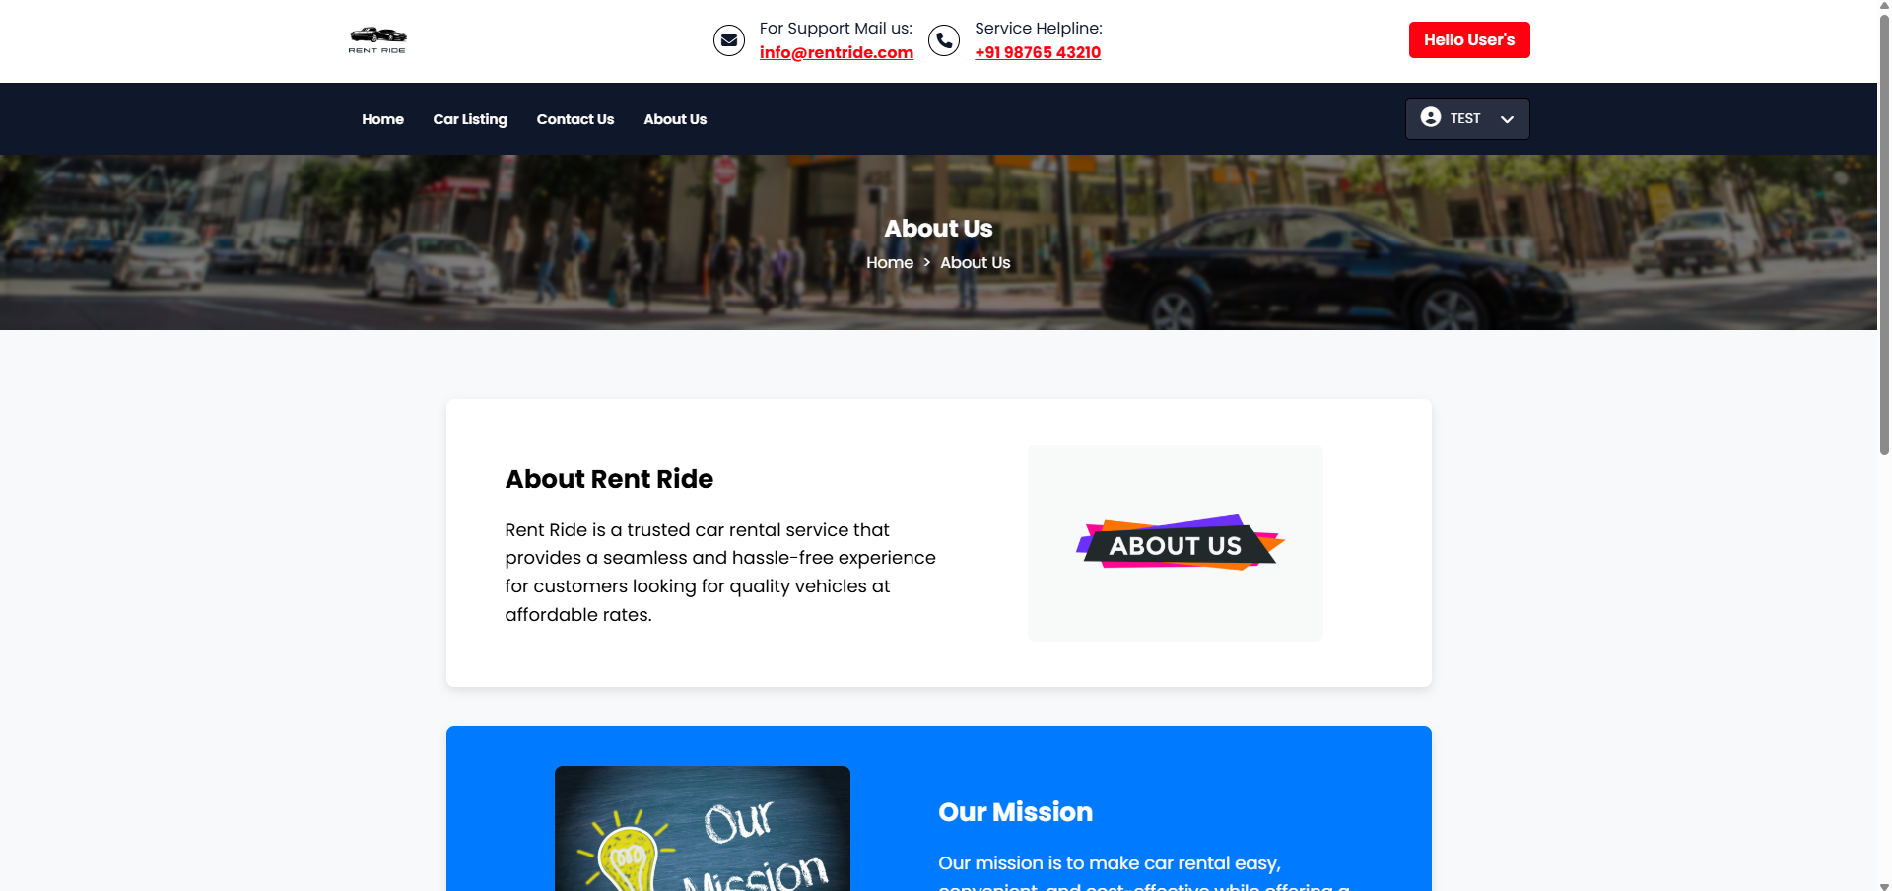
Layout
11) About As Page:

Slide 34
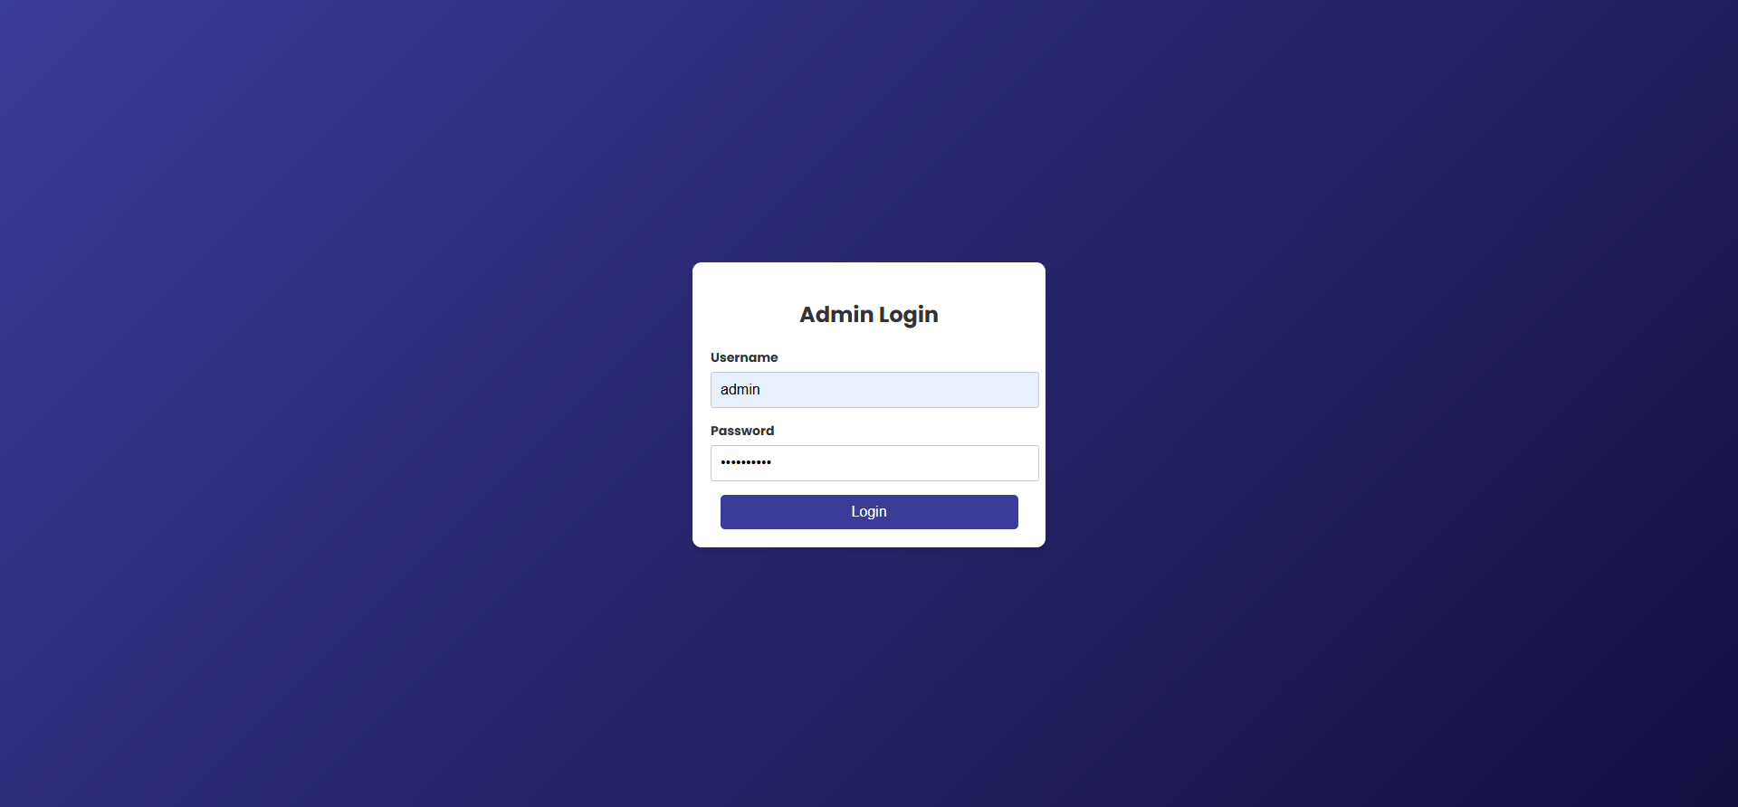
Layout for Admin Side:
Login Page:

Slide 35
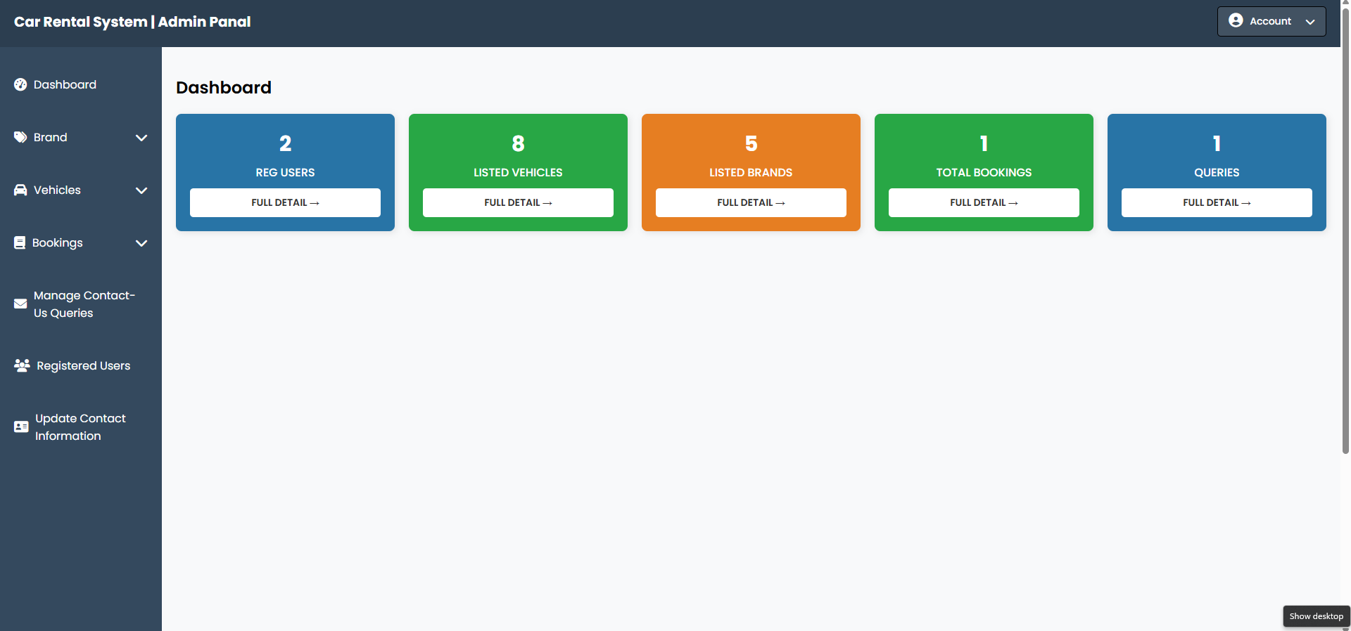
Layout
2) Dashboard Page:

Slide 36
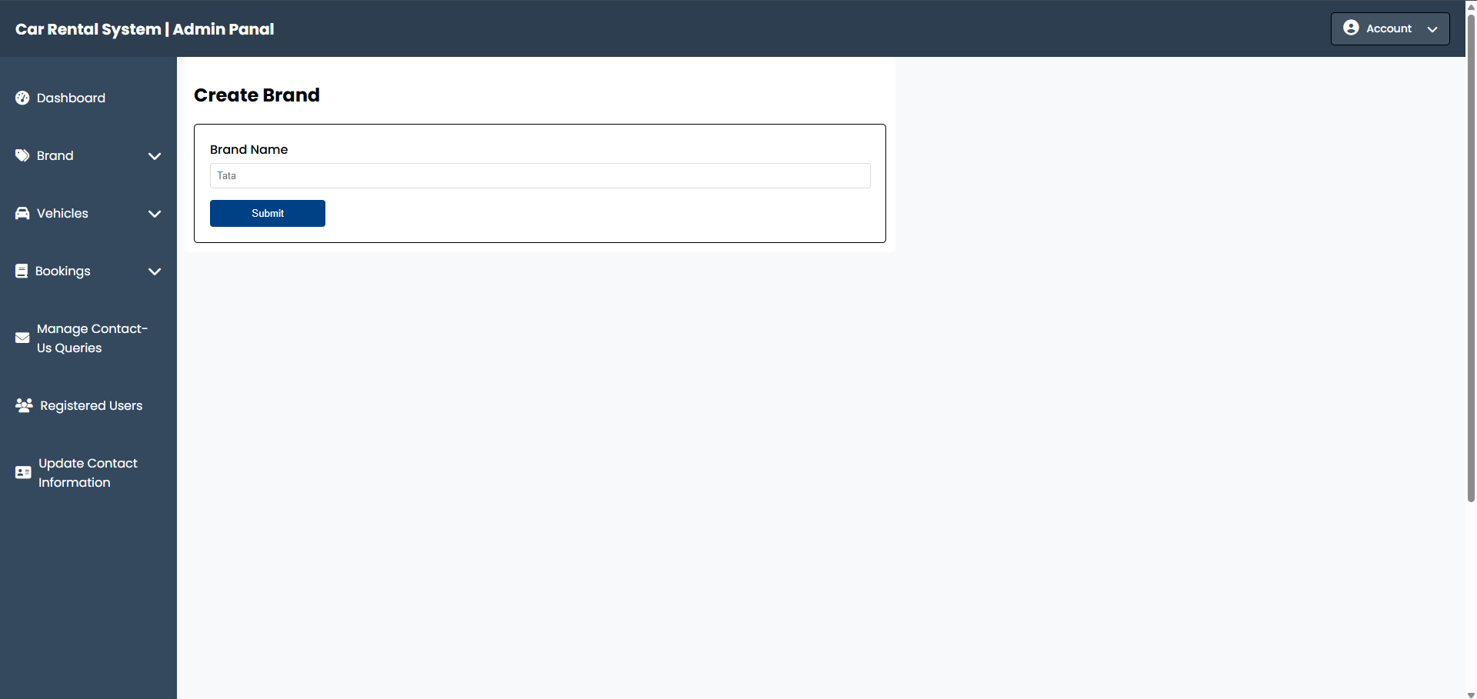
Layout
3) Create Brand Page:

Slide 37
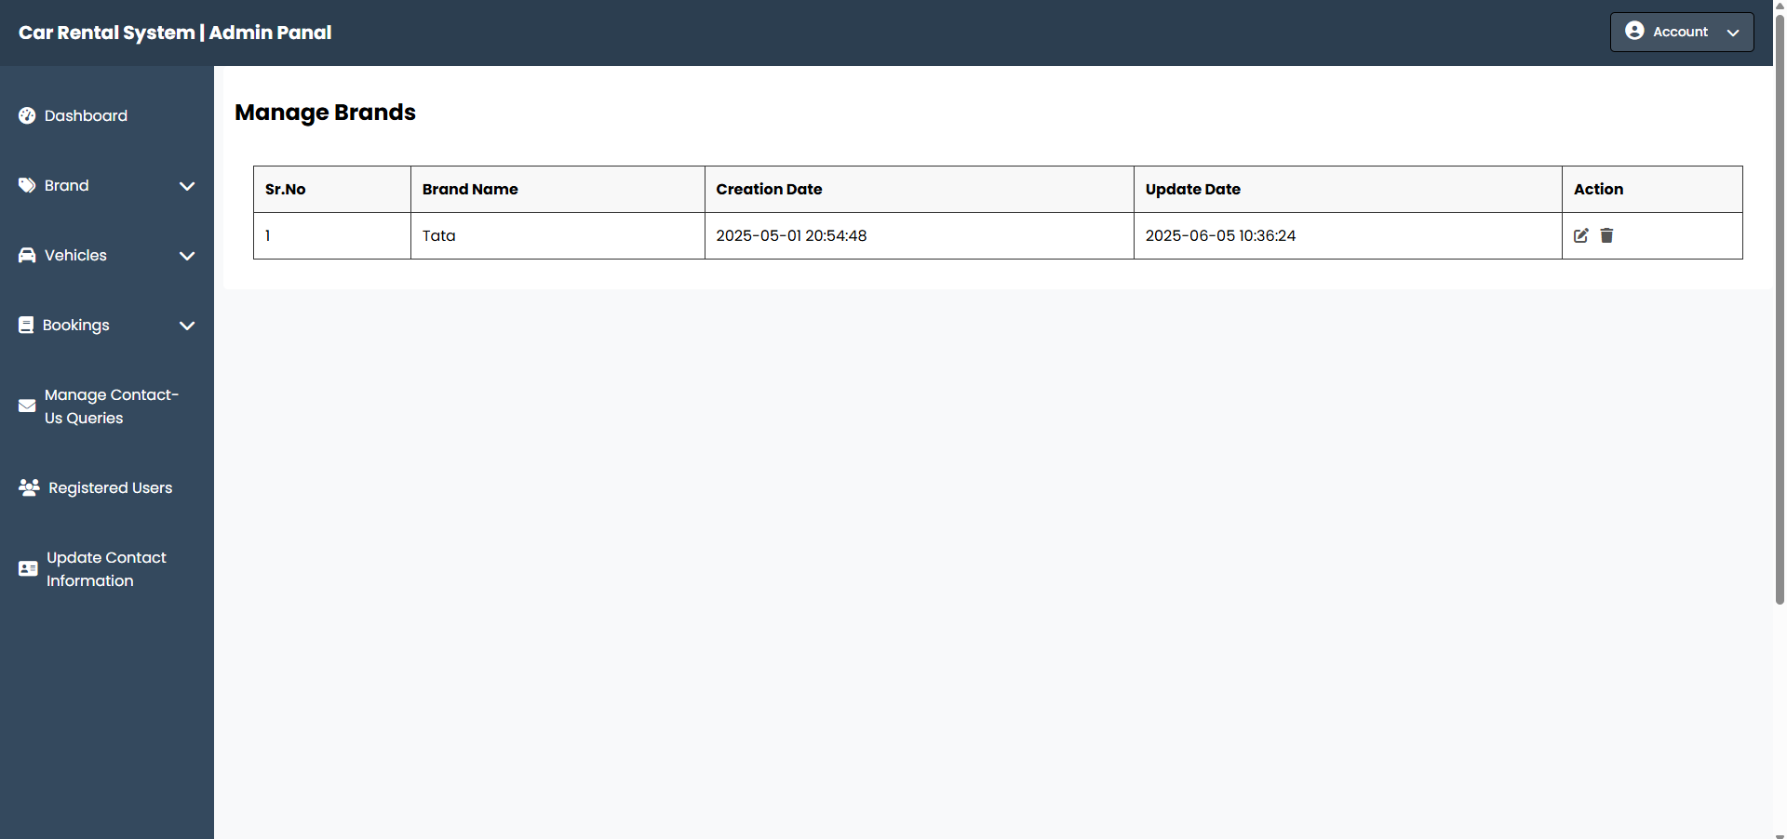
Layout
4) Manage Brand Page:

Slide 38
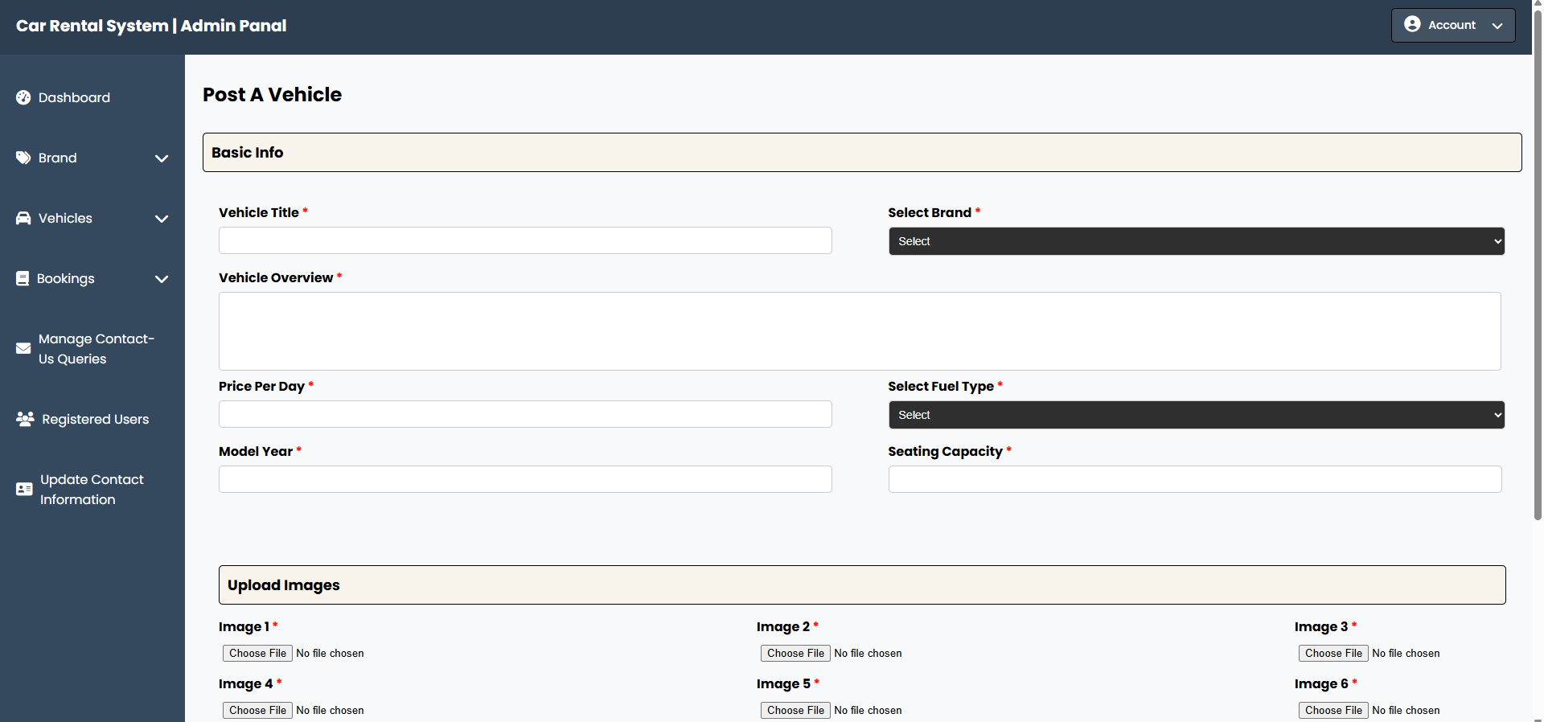
Layout
5) Post a Vehicle:

Slide 39
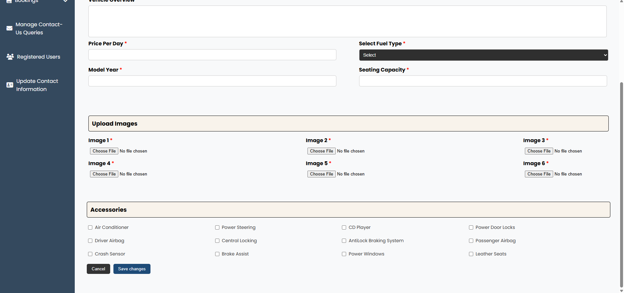
Layout
5.1) Post a Vehicle:

Slide 40
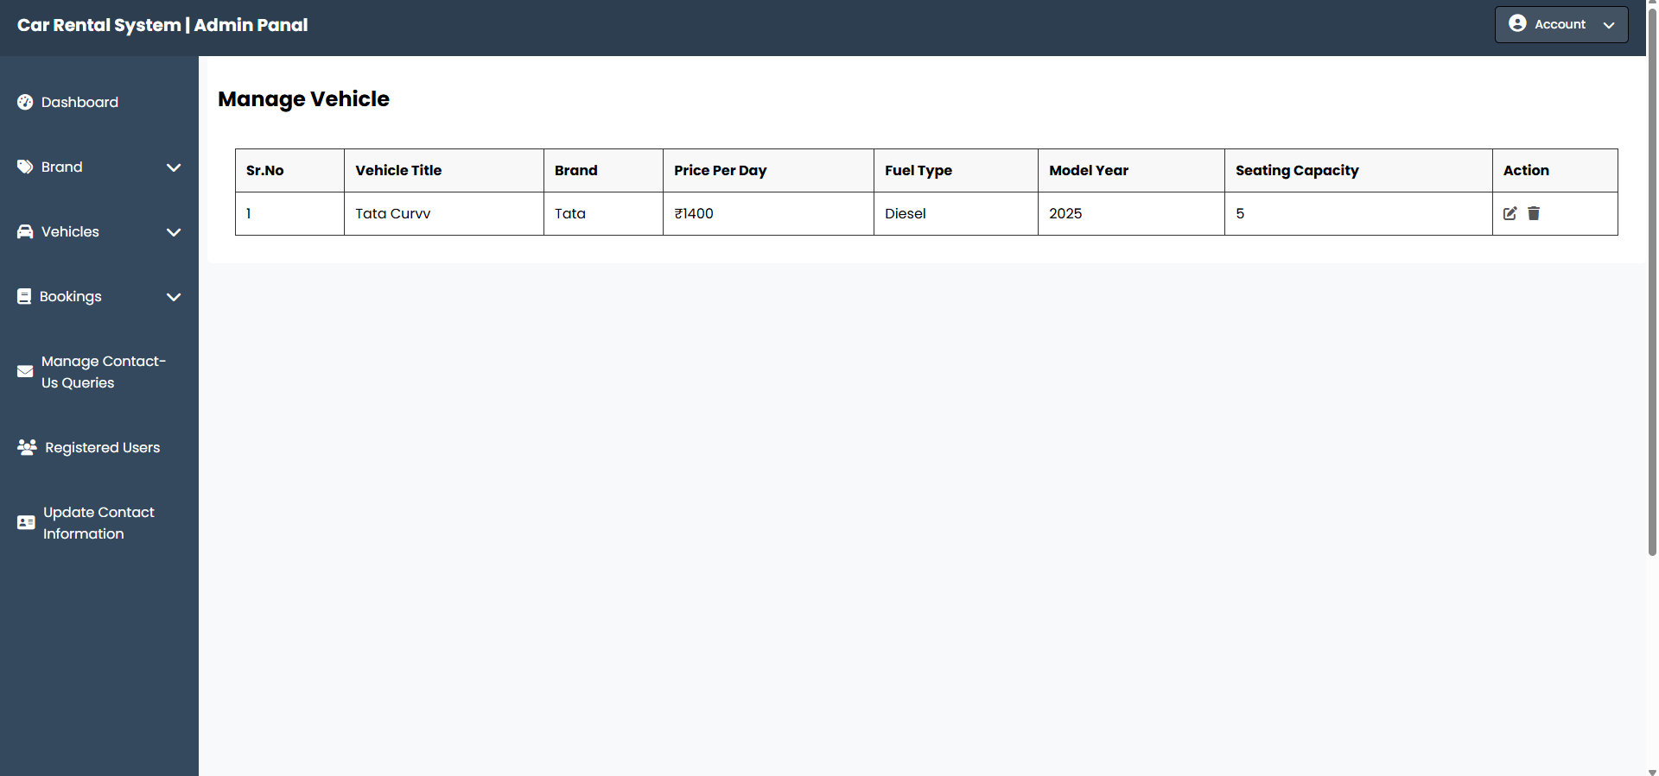
Layout
6) Manage Vehicle:

Slide 41
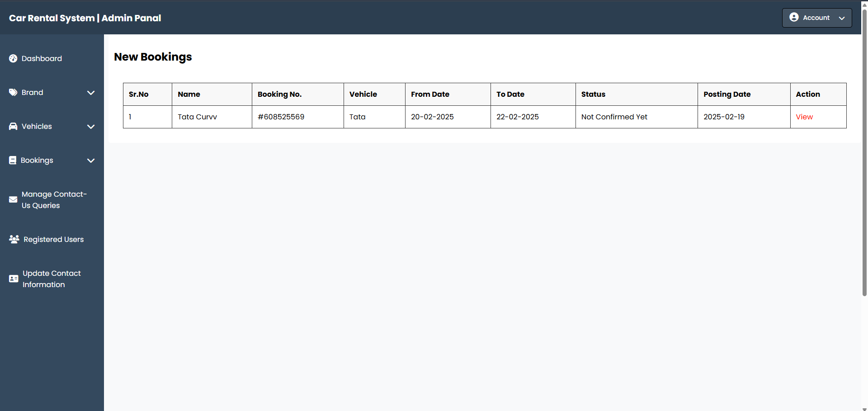
Layout
7) Booking Page:

Slide 42
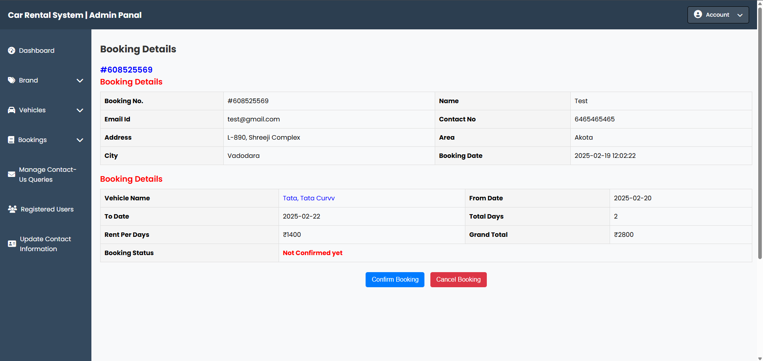
Layout
7.1) Booking Details Page:

Slide 43
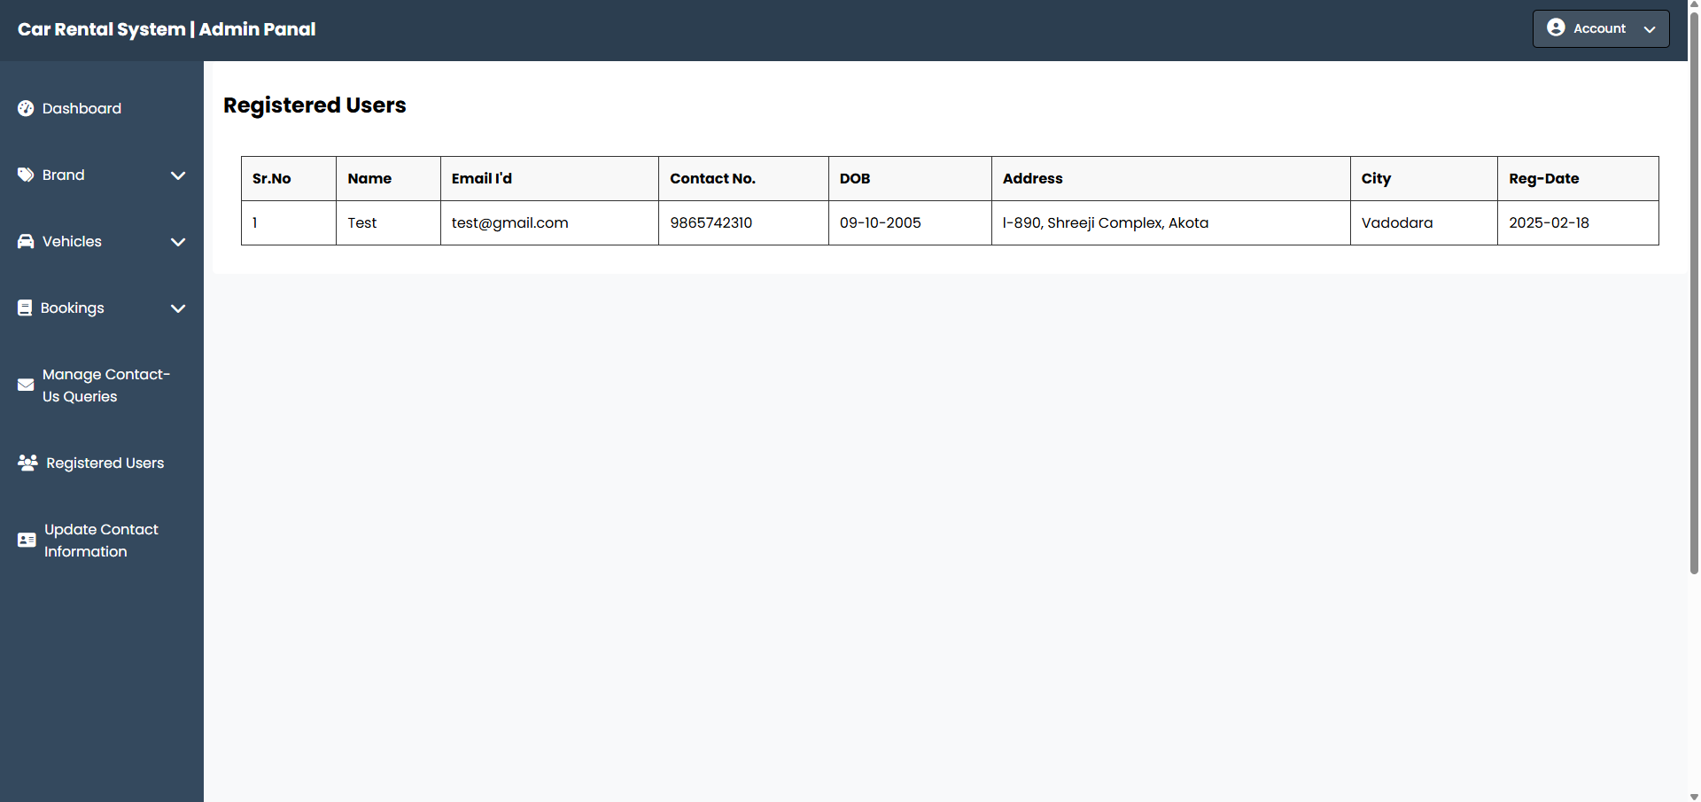
Layout
8) Registered Users Page:

Slide 44

Layout
9) Manage Contact Queries Page:

Slide 45
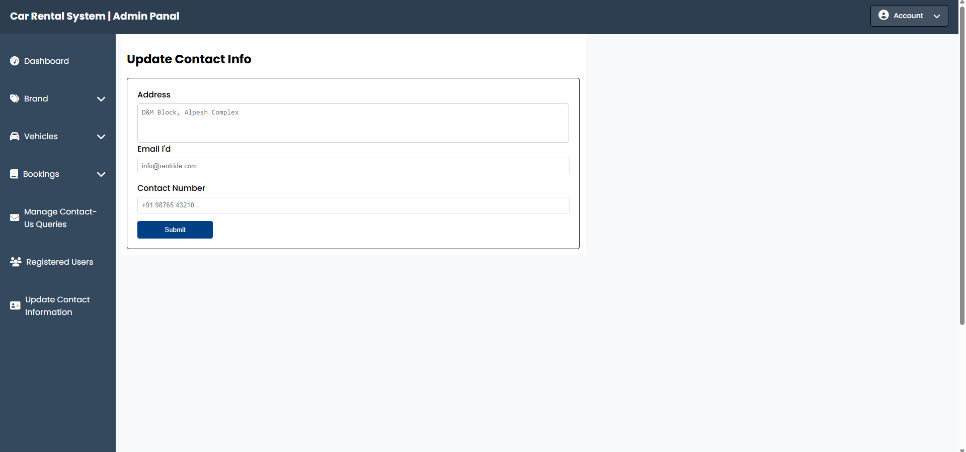
Layout
10) Update Contact Info. Page:

Slide 47


